Slide 1
Annual Report on the IA for Co-operation on Tokamak Programmes
Duarte Borba
on Behalf of Tony Donné EUROfusion
Chair, Executive Committee January 25, 2018

Slide 2
Outline
Objective and scope of the CTP-TCP
Chair’s report
Governance
Membership
Outreach
Highlights and milestones achieved
Future plans

Slide 3
Objective and scope of the CTP-TCP
Advance fusion science and technology by strengthening cooperation amongst tokamak programmes.
Promote exchanges related to the experimental programmes of the partner tokamak facilities
Design and planning of experiments to contribute to the database for next generation tokamak devices → support of activities identified by the International Tokamak Physics Activity (ITPA) operating under the auspices of the ITER Organization since 2009

Slide 4
Governance
CERT approved the request for extension of the CTP TCP for the period 1 July 2017 to 30 June 2022
ExCo unanimously agreed to revise the term of the Chair from one year to three years. Tony Donné (EU) was elected as the Chair of the Committee from 1 March 2017 to 29 February 2020. A Vice-Chair will be elected in the last year of the Chair’s term to ensure a transition between the outgoing and incoming Chairs.
The CTP TCP ExCo unanimously approved the change of the Japanese Contracting Party to "QST Japan".
The 8th ExCo Meeting was held 9 November 2017 at ITER Headquarters.

Slide 5
Membership
CTP TCP has 7 Contracting Parties (CPs)
3 IEA member countries: Japan, South Korea, USA
National Institutes for Quantum and Radiological Science and Technology (QST), Japan
The Korean Ministry of Education, Science and Technology (MEST), Korea.
United States Department of Energy (USDOE), United States
1 partner country India
The Institute for Plasma Research (IPR), India.
3 International Organizations:
European Atomic Energy Community (Euratom), European Union
ITER China Domestic Agency (CNDA)
ITER Organization

Slide 6
Membership
At the 7th ExCo Meeting the CPs agreed to invite Australia to join the CTP TCP. An invitation letter was sent and letter from the Australian Government was sent on 19 January 2018 with proposal of the “Australian Nuclear Science and Technology Organisation (ANSTO) as the Australia Government Contracting Party to the IEA Implementing Agreement for Co-operation on Tokamak Programmes (CTP TCP) ”.
CPs also recognised once more the importance of Russia as a major partner in the ongoing collaborations and agreed that the outgoing Chair is to prepare a new letter of invitation to Kurchatov Institute to join the CTP TCP.

Slide 7
Outreach
Main events during 2017
8th International Tokamak Physics Activities (ITPA) Joint Experiments Workshop (JEX) & 19th Meeting of the International Tokamak Physics Association (ITPA) Coordinating Committee & CTP-ITPA JEX Planning Meeting;
KSTAR Conference & Princeton Plasma Physics Laboratory (PPPL) Workshop on Theory and Simulation of Disruptions.
A representative of the CTP TCP attended the TCP Universal Meeting led by the IEA Executive Director in October 2017.
The CTP TCP has generated articles for inclusion in the IEA biennial publication Technology Collaboration Programmes: Highlights and outcomes.
Now that the website is active, the CTP TCP plans to announce developments through the OPEN Bulletin.

Slide 8
Personnel Assignments
Overviews of the most frequent assignments

Slide 9
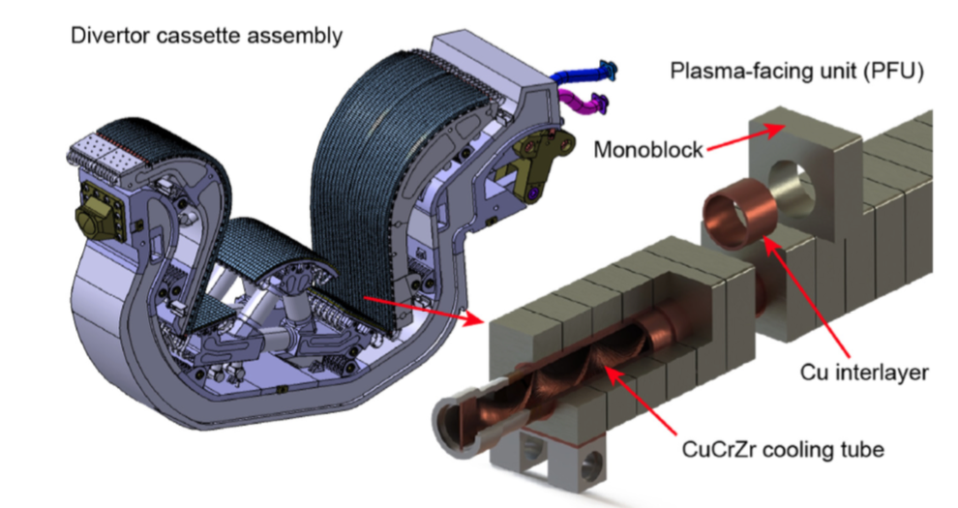
Key physics achievements
The key remaining physics design issue for the ITER tungsten (W) divertor is the question of monoblock (MB) front surface shaping in the high heat flux target areas of the actively cooled targets.

Slide 10
Key physics achievements
As a result, a coordinated multi-experiment and simulation effort was initiated via the International Tokamak Physics Activity (ITPA) and through ITER contracts, aimed at improving the physics basis supporting a Mono Block shaping decision from the point of view both of edge power loading and melt dynamics, with experiments on JET, DIII-D, KSTAR, COMPASS, Pilot-PSI, Magnum-PSI and ASDEX-Upgrade. It was concluded that MB top surface shaping is recommended to shadow poloidal gap edges in the high heat flux areas of the ITER divertor targets “R. Pitts et al Nuclear Materials and Energy 12 (2017) 60–74”

Slide 11
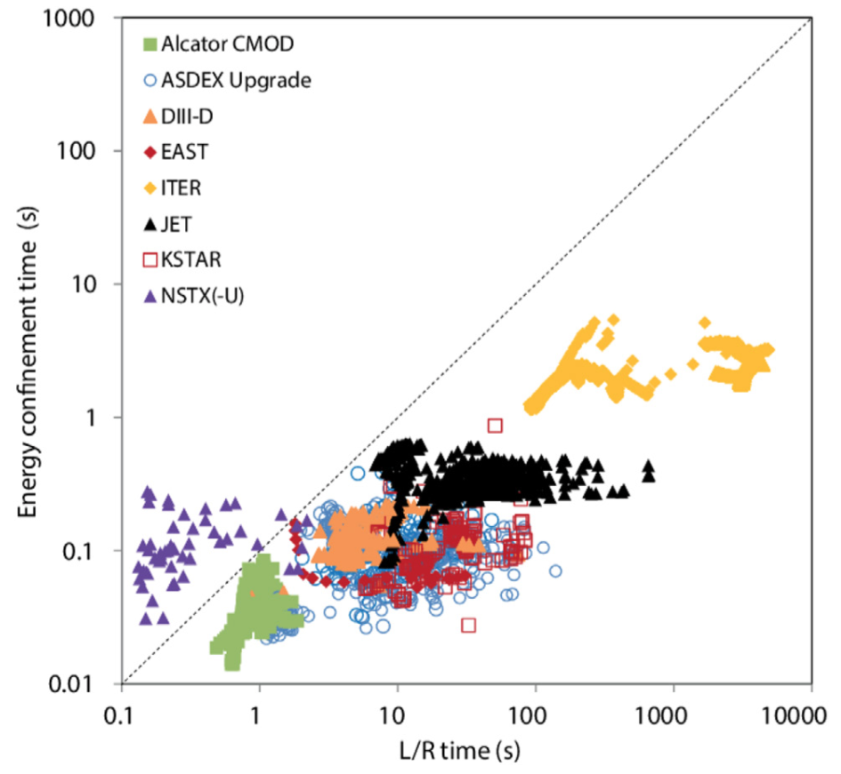
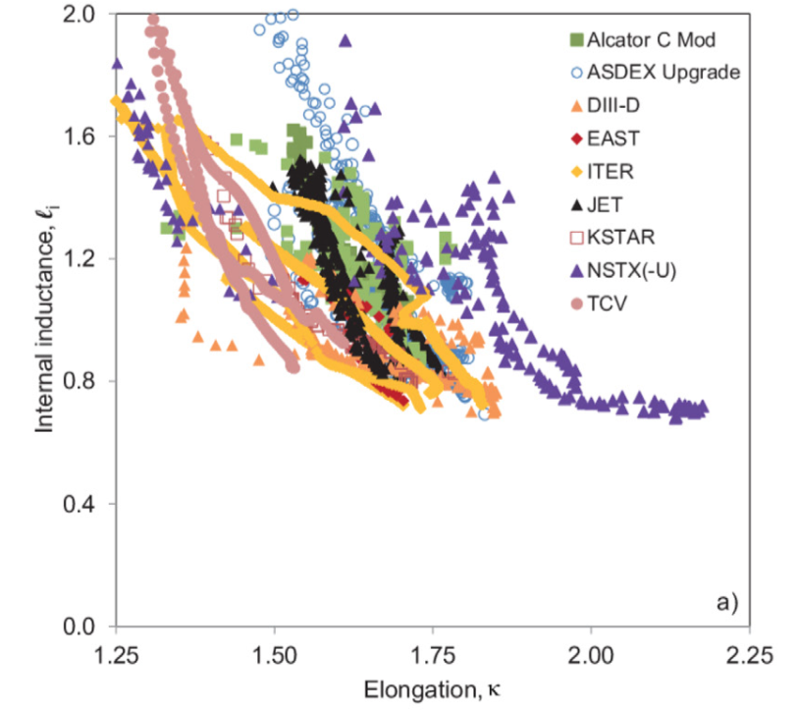
Key physics achievements
To improve our understanding of the dynamics and control of ITER terminations, a study has been carried out on data from existing tokamaks. The aim of this joint analysis is to compare the assumptions for ITER terminations with the present experience basis. The study examined the parameter ranges in which present day devices operated during their terminations, as well as the dynamics of these parameters “P. de Vries et al Nucl. Fusion 58 (2018) 026019”.

Slide 12
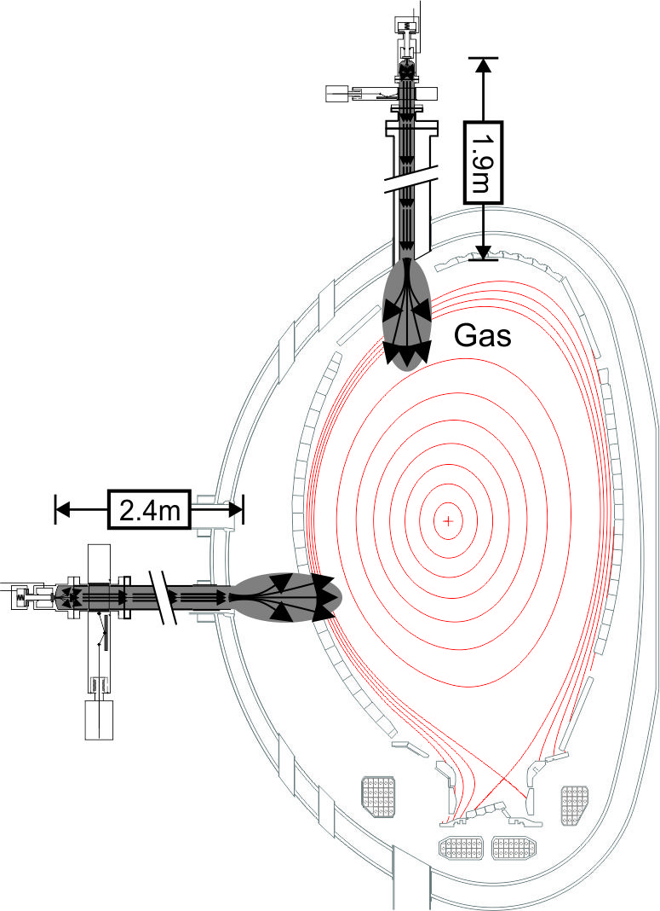
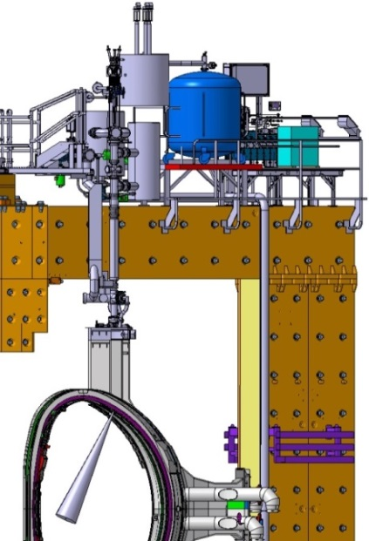
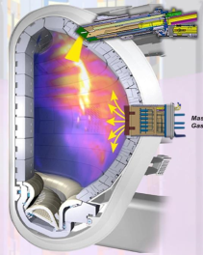
Future plans
Mitigation of disruptions a critical issue for ITER
Framework agreement between 4 CTP partners to design, construct, install and operate ITER relevant hardware on JET
Test the concept of Shattered Pellet Injection (SPI) for mitigation of runaway electrons during disruption current quench
Commissioning with plasma early in 2018 experimental campaign (May-October)

Slide 13
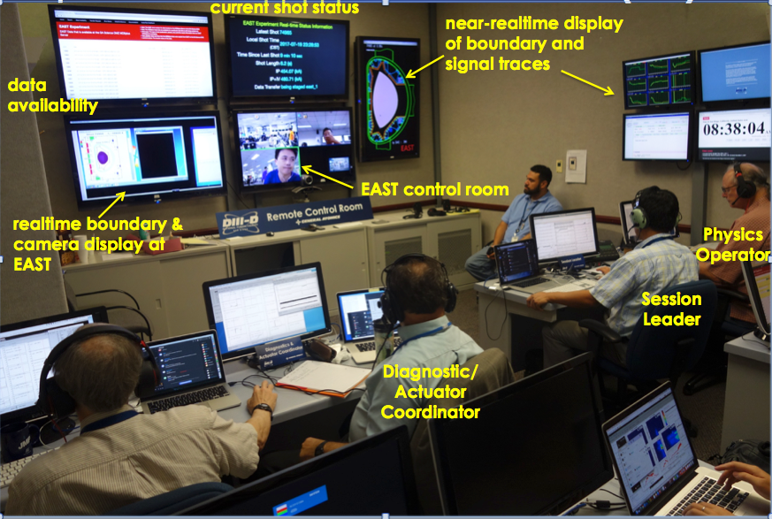
Future plans
Effective Remote Experiments Demonstrated
During EAST 3rd Shift Operations
Future Plans:
2018: 2-3 weeks of 3^{r} shift operations
2019: 4-6 weeks of 3rd shift operations
Issues:
ASIPP staff coverage for 11pm~5am shift
Coordination of 3rd shift experiments/resources with daytime campaign

Slide 14
Additional Slides

